Slide 1


Yogyawan
2024-03-25 (YYYY-MM-DD)

Slide 2

Outline
Executive Summary
Introduction
Methodology
Results
Conclusion
Appendix

Slide 3
Executive Summary
Summary of methodologies
Summary of all results

Slide 4
Introduction
Collecting, analyzing, visualizing, querying, make folium map & interactive dashboard, and machine learning of SpaceX data.

Slide 5

Section 1

Slide 6
Methodology
Executive Summary
Data collection methodology:
The data collected through API, web scraping, and download a dataset.
Perform data wrangling
Dealing with missing values and create a landing outcome label.
Perform exploratory data analysis (EDA) using visualization and SQL
Perform interactive visual analytics using Folium and Plotly Dash
Perform predictive analysis using classification models
Perform Logistics Regression Method, Support Vector Method, Decision Tree Method, and K-Nearest Neighbors Method.

Slide 7
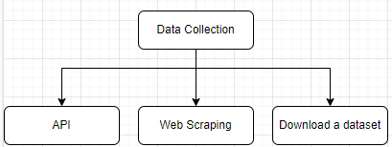
Data Collection
The data collected through JSON results, web scraping, and download a dataset.

Slide 8
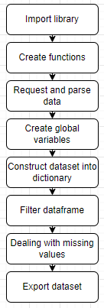
Data Collection – SpaceX API
Import Libraries and Define Auxiliary Functions
Request and parse the SpaceX launch data using the GET request
Filter the dataframe to only include Falcon9 launches
Data wrangling
Dealing with missing values
https://github.com/Twentsix/ForCourseraForLearning/blob/cc699aed01d898c19206a90fbbc46b11743d4499/FinalProject/10-1-2x%20jupyter-labs-spacex-data-collection-api_Executed.ipynb

Slide 9
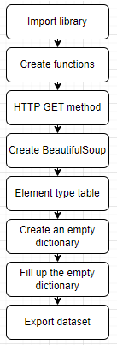
Data Collection - Scraping
Request the Falcon9 Launch Wiki page from its URL
Extract all column/variable names from the HTML table header
Create a data frame by parsing the launch HTML tables
https://github.com/Twentsix/ForCourseraForLearning/blob/cc699aed01d898c19206a90fbbc46b11743d4499/FinalProject/10-1-4x%20jupyter-labs-webscraping_Executed.ipynb

Slide 10
Data Wrangling
Import libraries, dealing missing values, calculate, and export
Calculate the number of launches on each site
Calculate the number and occurrence of each orbit
Calculate the number and occurence of mission outcome of the orbits
Create a landing outcome label from Outcome column
https://github.com/Twentsix/ForCourseraForLearning/blob/cc699aed01d898c19206a90fbbc46b11743d4499/FinalProject/10-1-6x%20labs-jupyter-spacex-Data%20wrangling_Executed.ipynb

Slide 11
EDA with Data Visualization
Using catplot from seaborn library to see a correlation between variables across dataset, and also using bar chart to see a relationship between variables, and using line chart to see a trends.
https://github.com/Twentsix/ForCourseraForLearning/blob/cc699aed01d898c19206a90fbbc46b11743d4499/FinalProject/10-2-4x%20jupyter-labs-eda-dataviz.ipynb.jupyterlite_Executed.ipynb

Slide 12
EDA with SQL
To display unique launch sites in the space mission
To display the total payload mass, average payload mass, list of date, name of boosters, total number of mission outcomes, and count of landing outcomes carried by boosters launched by NASA
https://github.com/Twentsix/ForCourseraForLearning/blob/cc699aed01d898c19206a90fbbc46b11743d4499/FinalProject/10-2-2x%20jupyter-labs-eda-sql-coursera_sqllite_Executed.ipynb

Slide 13
Build an Interactive Map with Folium
Adding marker and label to each points of latitudes and longitudes of launch sites of SpaceX and also distances on given site map
To add clarity and also knowledge of where the information of launch sites.
https://github.com/Twentsix/ForCourseraForLearning/blob/cc699aed01d898c19206a90fbbc46b11743d4499/FinalProject/10-3-2x%20lab_jupyter_launch_site_location.jupyterlite_Executed.ipynb

Slide 14
Build a Dashboard with Plotly Dash
Adding pie chart and scatter plot to see a percentage and relationships between payload mass (kg) and each classes.
To see each different classes to its own group.
https://github.com/Twentsix/ForCourseraForLearning/blob/cc699aed01d898c19206a90fbbc46b11743d4499/FinalProject/spacex_dash_app.py

Slide 15
Predictive Analysis (Classification)
Logistics Regression Method, Support Vector Method, Decision Tree Method, K-Nearest Neighbors Method
To_numpy(), X_train, X_test, Y_train, Y_test, score(), predict(), fit(), DecisionTreeClassifier()
https://github.com/Twentsix/ForCourseraForLearning/blob/cc699aed01d898c19206a90fbbc46b11743d4499/FinalProject/10-4-2x%20SpaceX_Machine_Learning_Prediction_Part_5.jupyterlite_Executed.ipynb

Slide 16
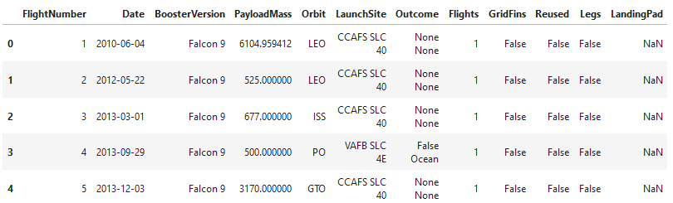
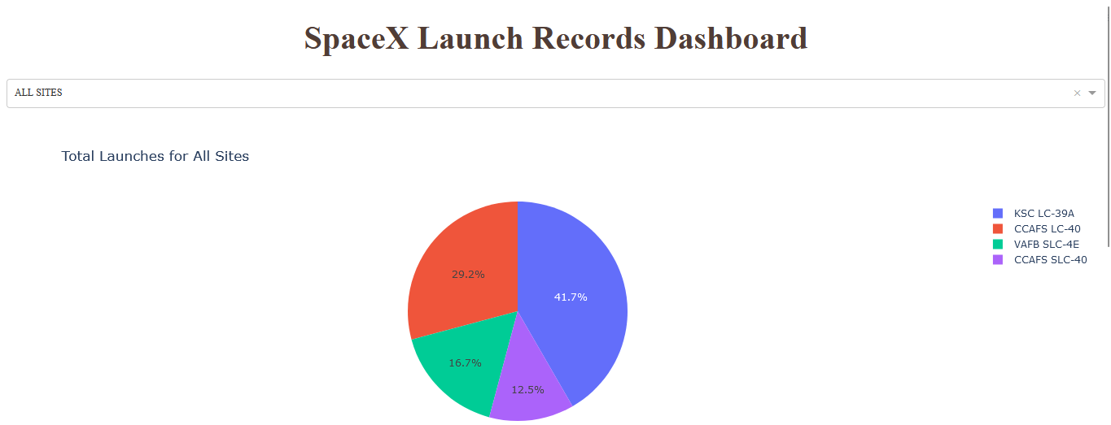
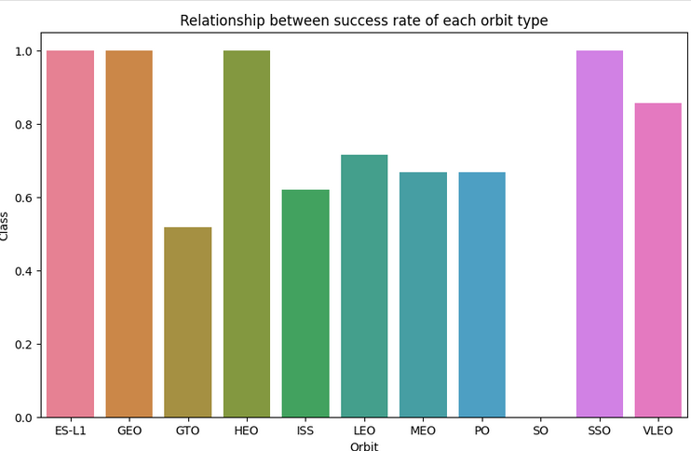
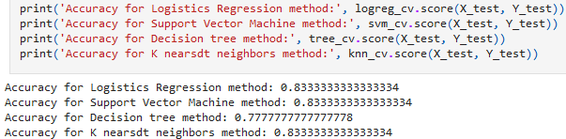
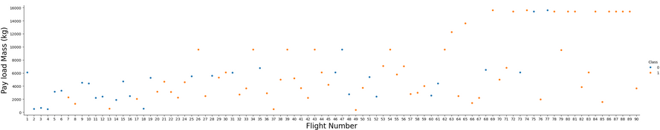
Results

Slide 17

Section 2

Slide 18
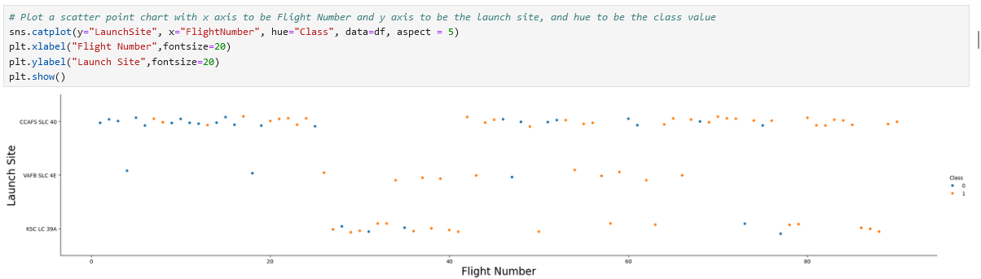
Flight Number vs. Launch Site
Relationship between Flight Number vs. Launch Site.

Slide 19
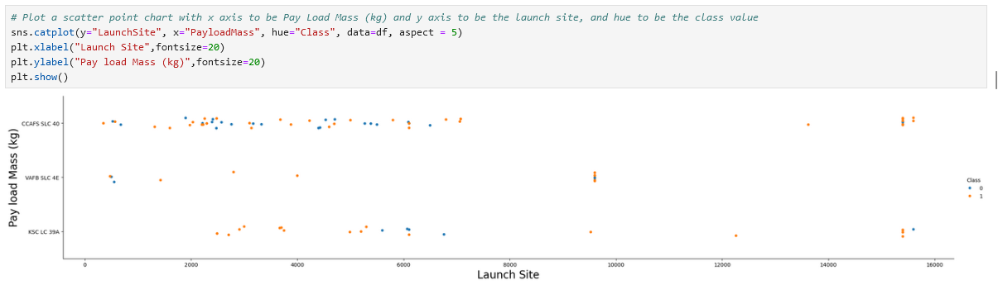
Payload vs. Launch Site
Relationship between Payload vs. Launch Site.

Slide 20
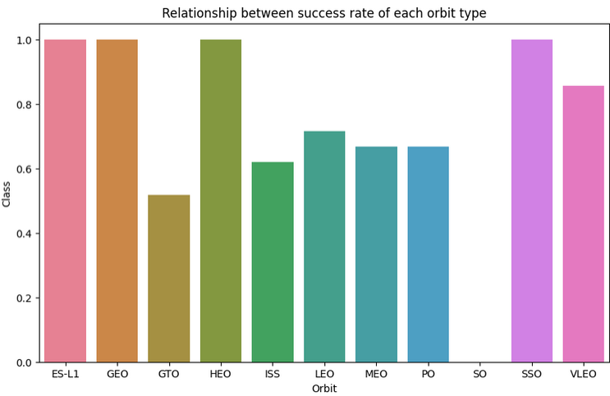
Success Rate vs. Orbit Type
ES-L1, GEO, HEO, and SSO have a higher success.

Slide 21
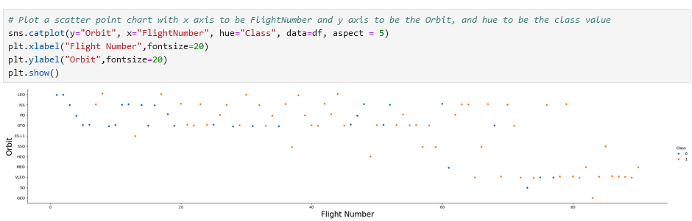
Flight Number vs. Orbit Type
Relationship between Flight Number vs. Orbit Type.

Slide 22
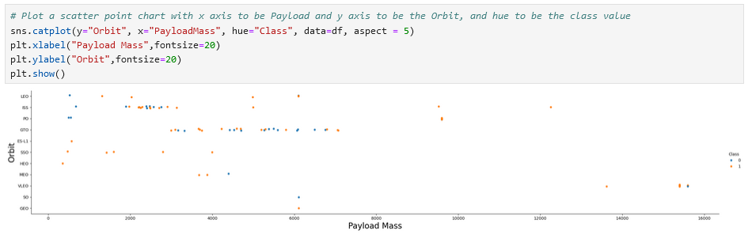
Payload vs. Orbit Type
Relationship between Payload vs. Orbit Type.

Slide 23
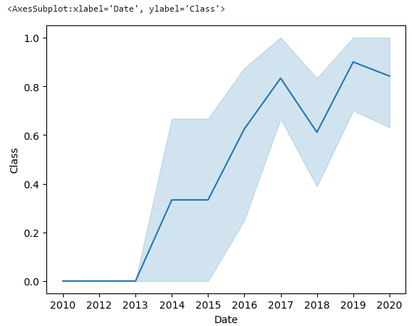
Launch Success Yearly Trend
The success rate since 2013 kept increasing till 2020.

Slide 24
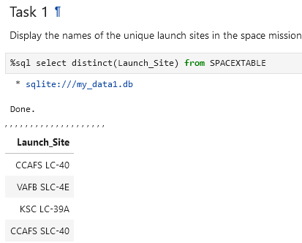
All Launch Site Names
There are 4 unique name of each launch sites which is:
CCAFS LC-40
VAFB SLC-4E
KSC LC-39A
CCAFS SLC-40

Slide 25
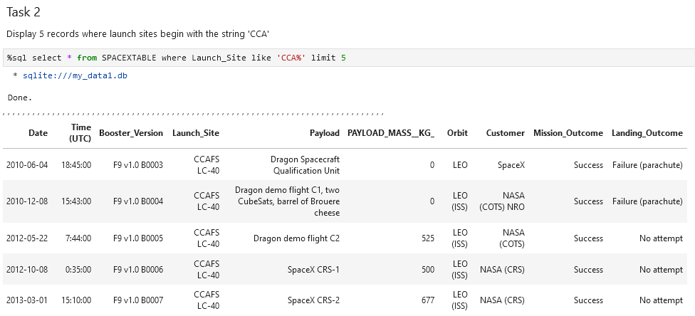
Launch Site Names Begin with 'CCA'
Display top 5 rows of launch sites with the name begins with ‘CCA’

Slide 26
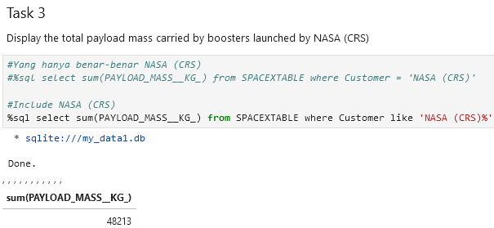
Total Payload Mass
Total payload mass (Kg) launched by NASA (CRS) with 48213 Kg

Slide 27
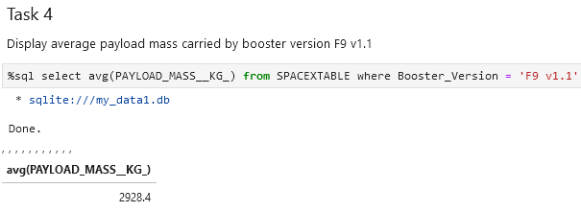
Average Payload Mass by F9 v1.1
Average payload mass (Kg) carried by booster version F9 v1.1 with 2928.4 Kg

Slide 28
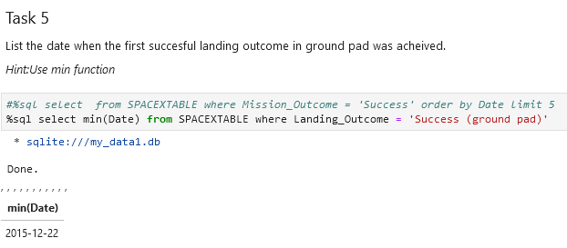
First Successful Ground Landing Date
It was on Dec, 22th 2015 the first successful landing outcome in ground pad achieved.

Slide 29
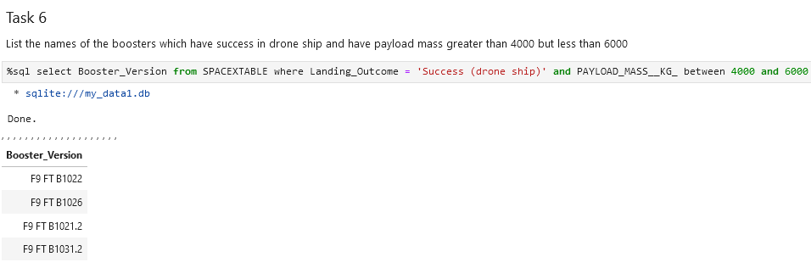
Successful Drone Ship Landing with Payload between 4000 and 6000
There are 4 booster version which have success in drone ship and have payload mass greater than 4000 Kg but less than 6000 Kg, which are:
F9 FT B1022, F9 FT B1026, F9 FT B1021.2, F9 FT B1031.2

Slide 30
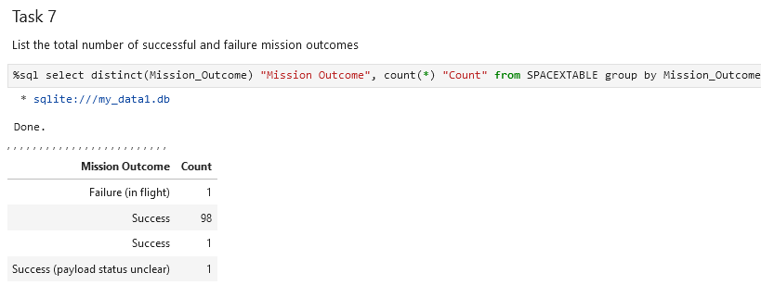
Total Number of Successful and Failure Mission Outcomes
There are 101 success and 1 failure from the data.

Slide 31
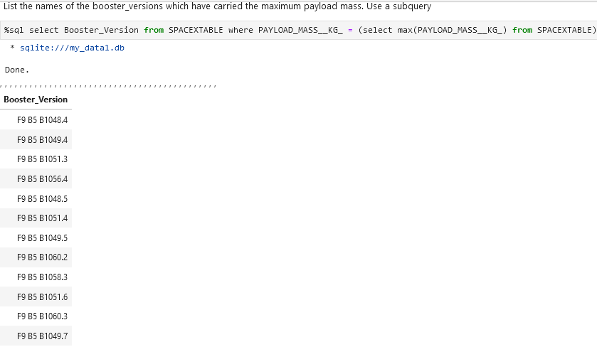
Boosters Carried Maximum Payload
There are 12 booster version which have carried the maximum payload mass (Kg)

Slide 32
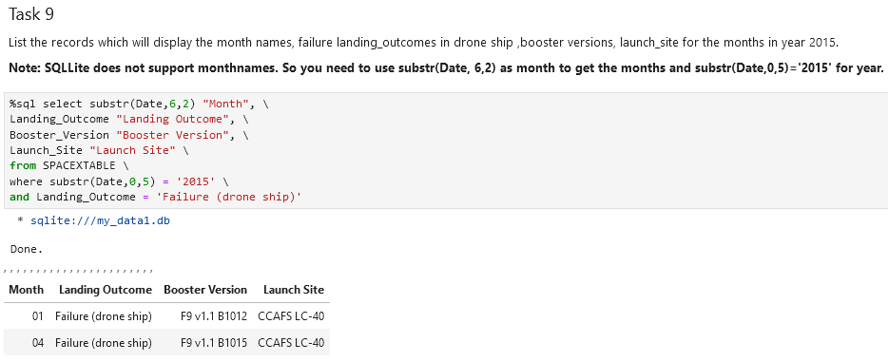
2015 Launch Records
There are 2 failure landing outcomes in drone ship in the year 2015.

Slide 33
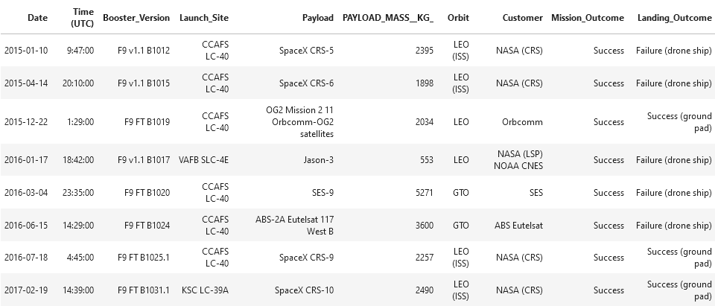
Rank Landing Outcomes Between 2010-06-04 and 2017-03-20
There are 8 records in total, which is landing outcomes such as success and failure between the date June, 4th 2010 until March, 20th 2017.

Slide 34

Section 3

Slide 35
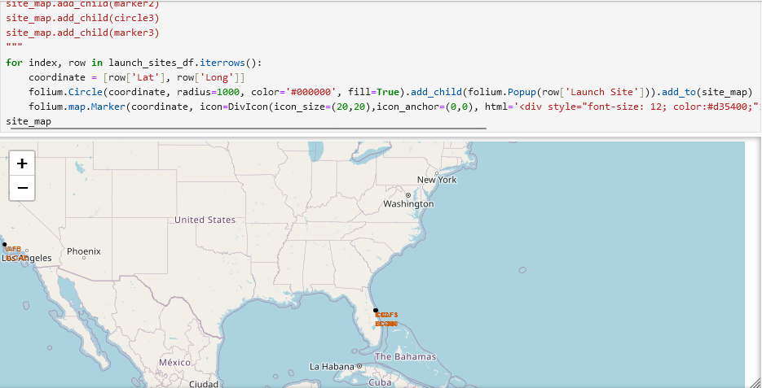
4 Launch Sites
Folium map with 4 different sites and markers for each launch sites.

Slide 36
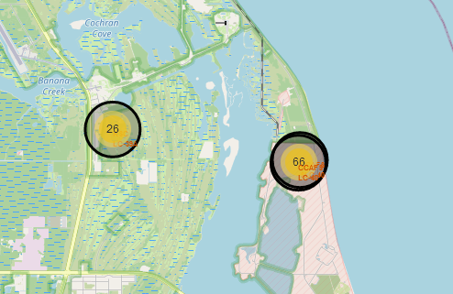
Markers for Success and Failure
Updated version from the last folium map, which added color for each markers for each launch sites.

Slide 37
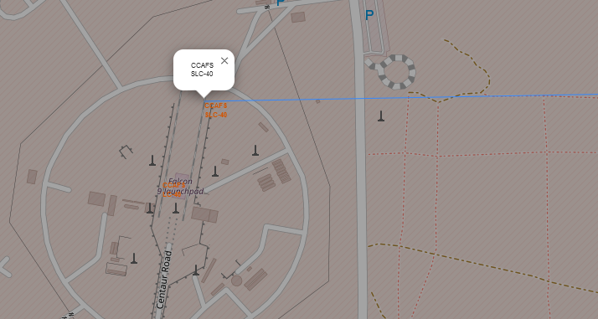
Distance between launch site and coastline point
Added Polyline between launch site to the selected coastline point.

Slide 38

Section 4

Slide 39
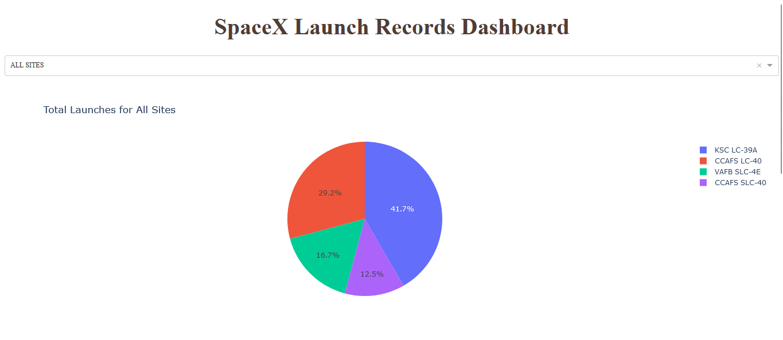
SpaceX Launch Records Dashboard

Slide 40
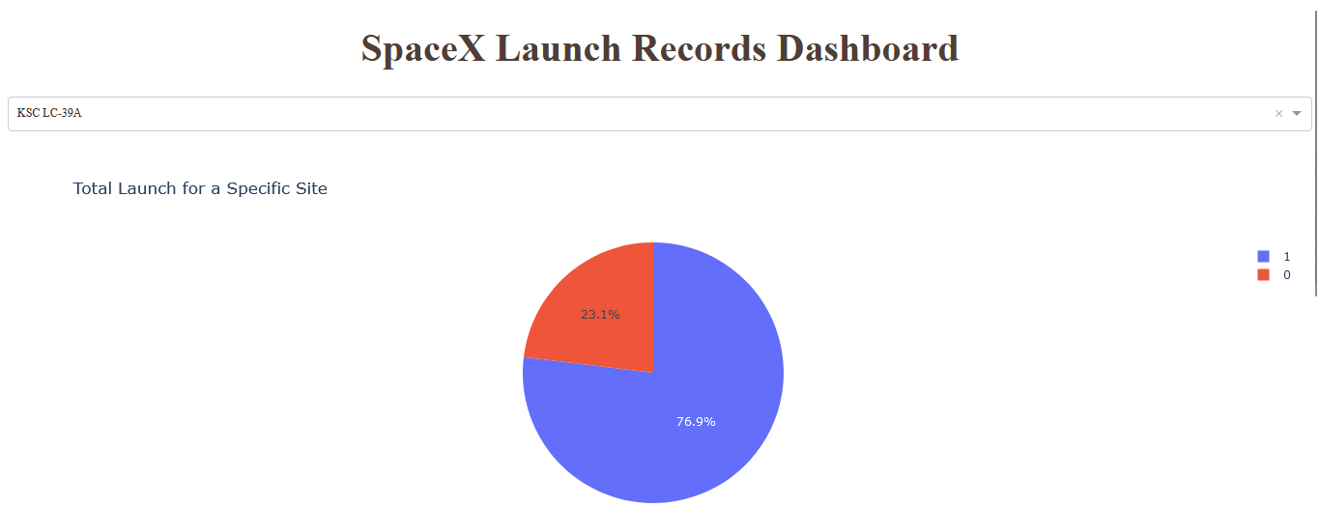
SpaceX Launch Records Dashboard with Highest Launch Success Ratio

Slide 41
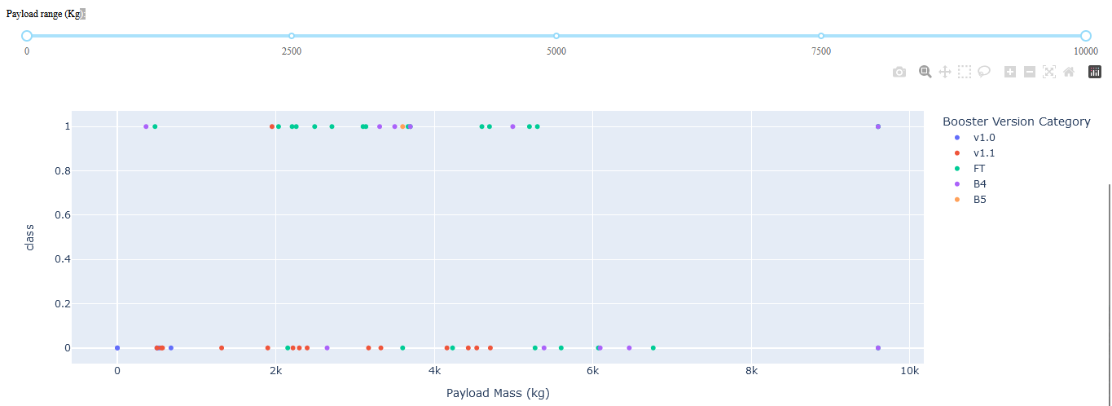
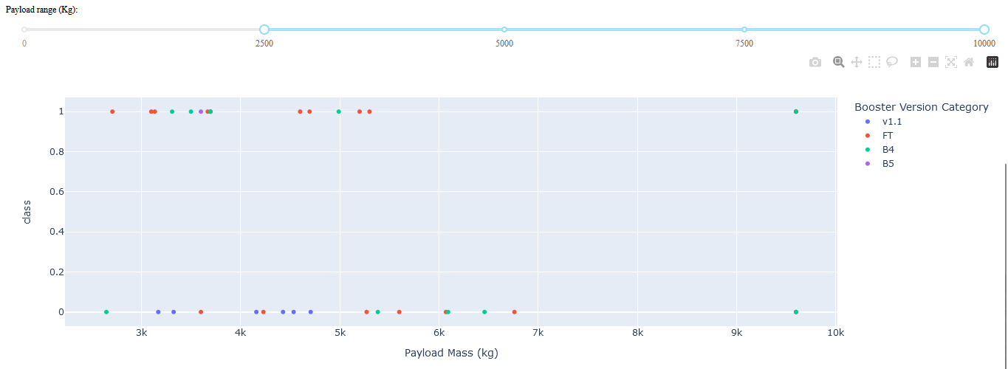
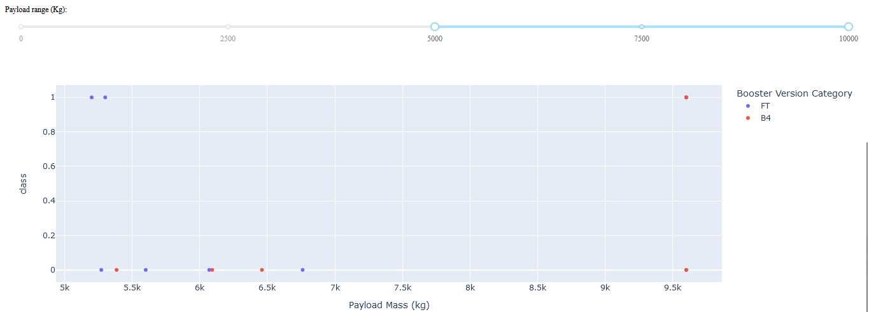
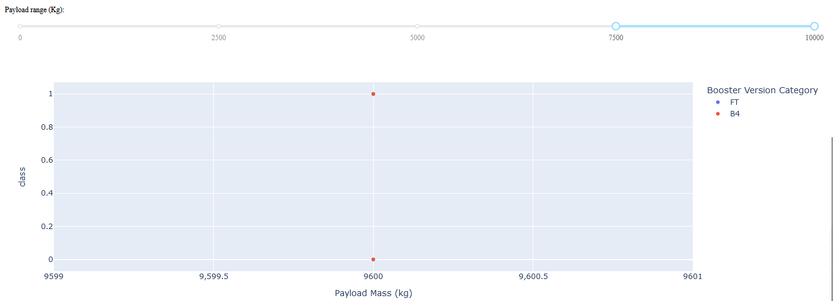
SpaceX Launch Records Dashboard Scatter

Slide 42

Section 5

Slide 43
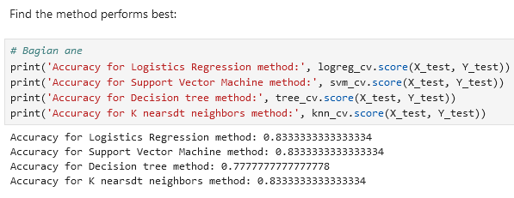
Classification Accuracy

Slide 44
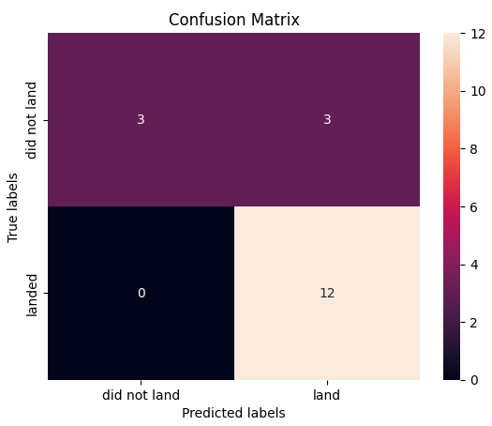
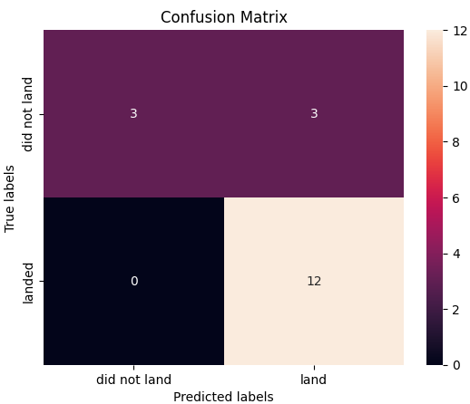
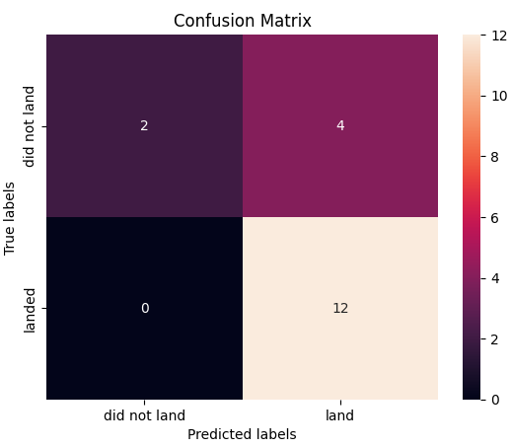
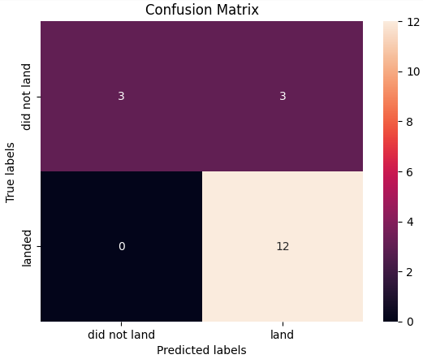
Confusion Matrix

Slide 45
Conclusions
The highest classification accuracy are Logistics Regression method, Support Vector Machine method, and K-Nearest Neighbors method.

Slide 46
Appendix
https://github.com/Twentsix/ForCourseraForLearning/tree/cc699aed01d898c19206a90fbbc46b11743d4499/FinalProject

Slide 47
Insights
Perhaps by providing interactive dashboard and folium like map to public might help others interested in data science, rather than dataset in CSV format or others that need to be analyzed first.

Slide 48


